Slide 1
Notes:
Welcome - This presentation is on behalf of Saskatoon Public Schools. We plan to share information with you about the transition to high school including information about our collegiates and overview the registration process that will occur. Please feel free to ask questions throughout the presentation.

Slide 2
Notes:
Saskatoon Public School strives to know, value and believe in each of our students. We have committed to creating learning experiences that inspire all students to reach their potential. School teams are working hard every day to create safe, caring and accepting school for all our students.

Slide 3
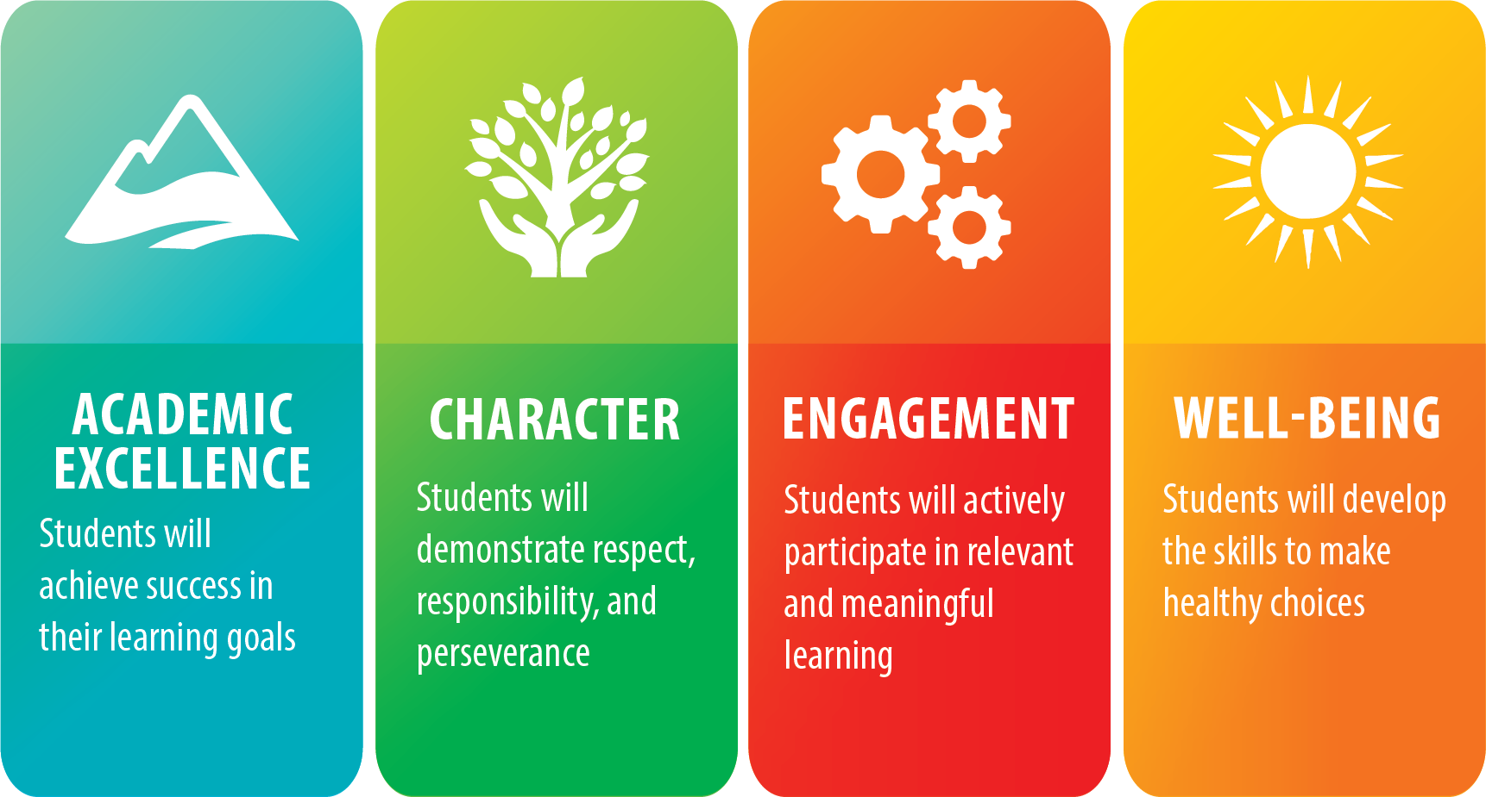
Through a focus on our four student goals—Academic Excellence, Character, Engagement, Well-being—we are preparing students for an evolving world with the necessary skills, character traits, and knowledge they will need for their future.
Notes:
As we work with students each day, Saskatoon Public Schools plan is to focus on students, above all else. The four pillars on the screen guide our work. School teams create opportunities daily for students to show evidence of their learning while striving for Academic Excellence in each subject area. We are working hard at providing multiple opportunities for students to master curricular outcomes and consider how what they are learning impacts the world around them. Character, Engagement, and Well-Being go hand in hand with Academic Excellence. Engaged students actively participate in their learning and find meaning in what they are doing. We hope to build character through social and academic interactions as we work with students to understand what respect, responsibility and perseverance looks like. Understanding and learning the skills to make healthy choices enhances a student’s well-being.

Slide 4
First Nations, Inuit and Métis Education Unit
The First Nations, Inuit and Métis Education Unit takes leadership in ensuring the success of Indigenous students attending Saskatoon Public Schools.
The First Nations, Inuit and Métis Education Unit works towards the fulfillment of the following goals:
Advancing system-wide learning and unlearning about the shared history of Indigenous and non-Indigenous people.
Honouring First Nation, Inuit and Métis presence in schools, classrooms and curriculum.
Fostering balanced and respectful relationships with Indigenous students as an active participant on their learning journey.
Ensuring equitable outcomes from Métis, First Nation and Inuit students.
Notes:
Read screen or notes need to be added

Slide 5
Saskatoon Public Schools values the diversity of cultures and worldviews in our communities.
Notes:
Saskatoon Public Schools is committed to being a culturally responsive school division. It values and recognizes the vital role that culture plays in the development of strong learners, schools and communities.

Slide 6
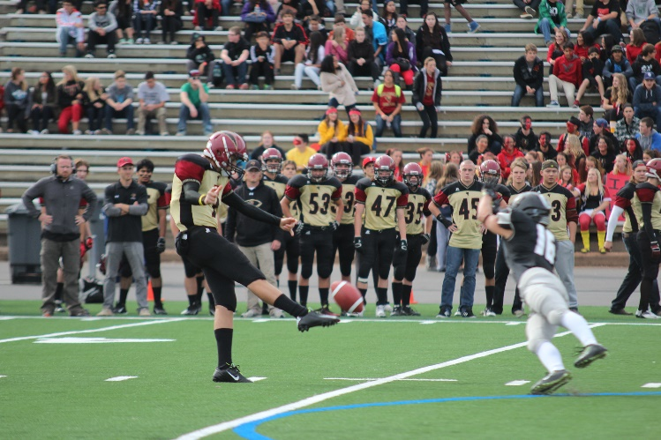
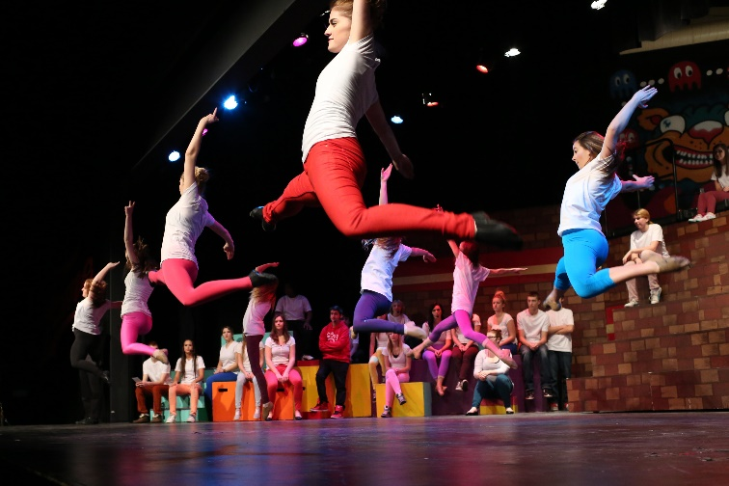
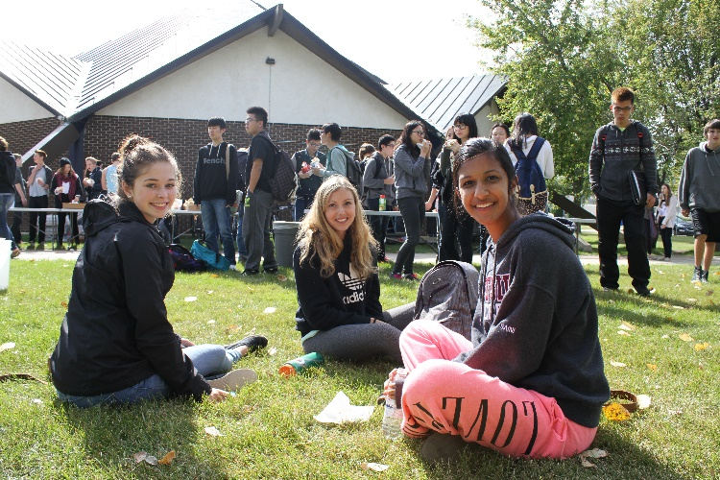
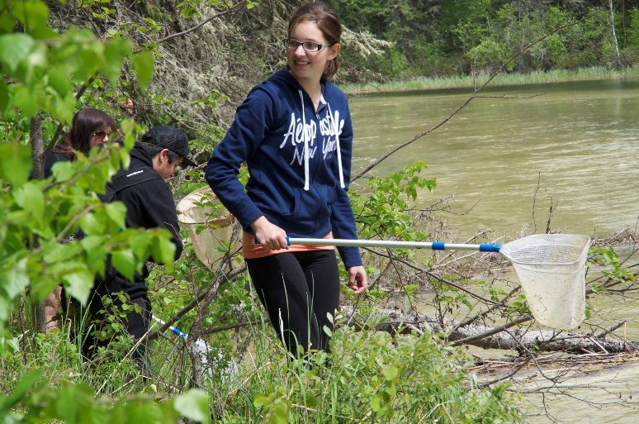
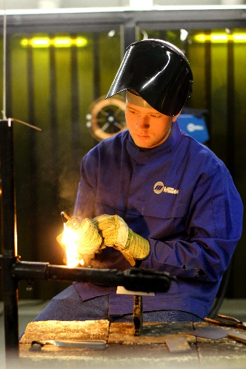
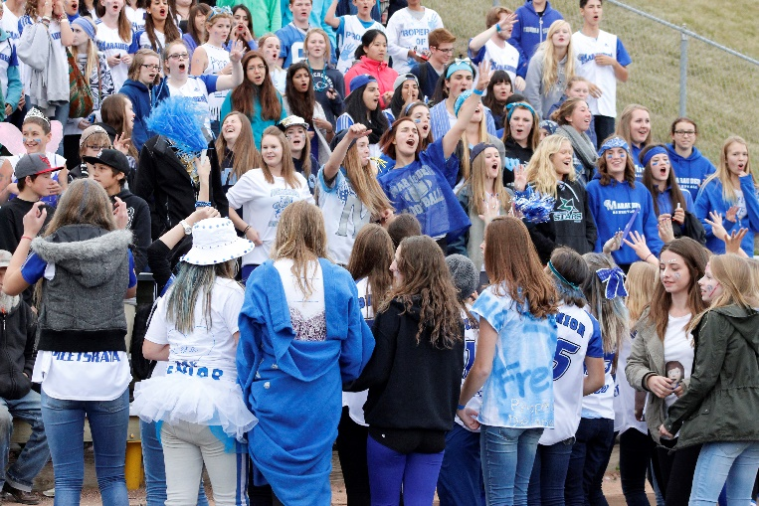
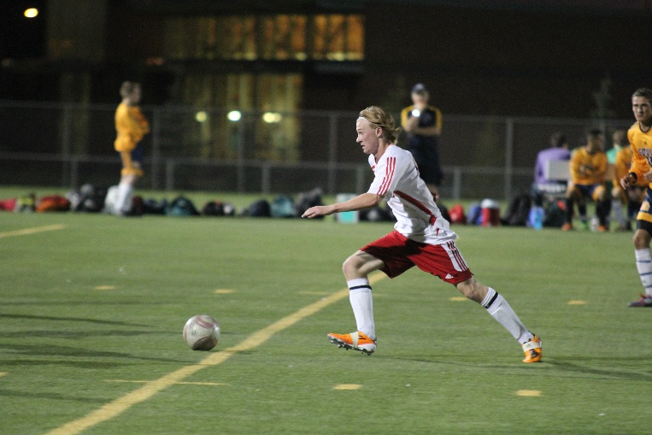
Transition to High School
Notes:
We hope you are excited about the possibilities high school brings! We are certainly excited to be part of this next chapter of your education.

Slide 7
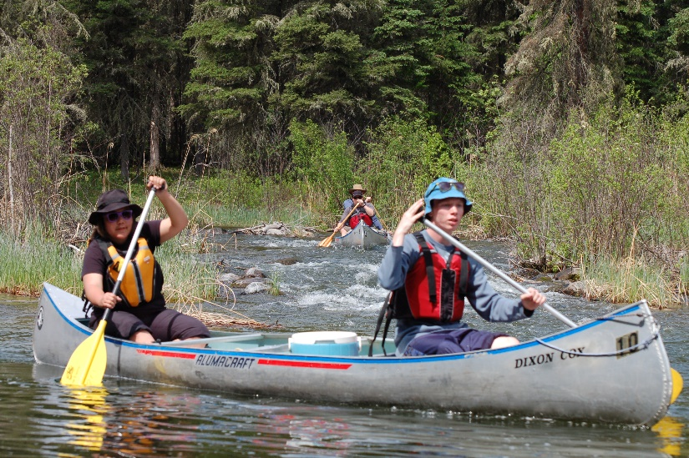
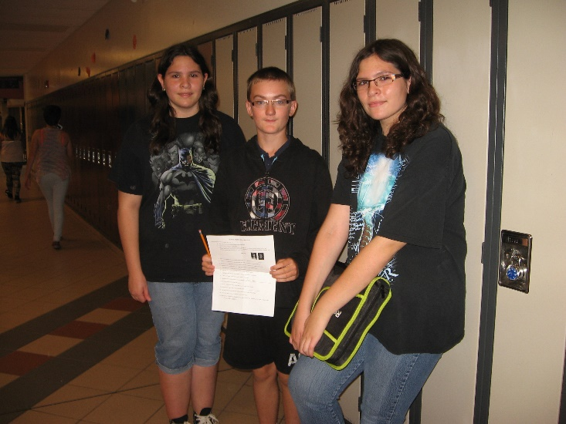
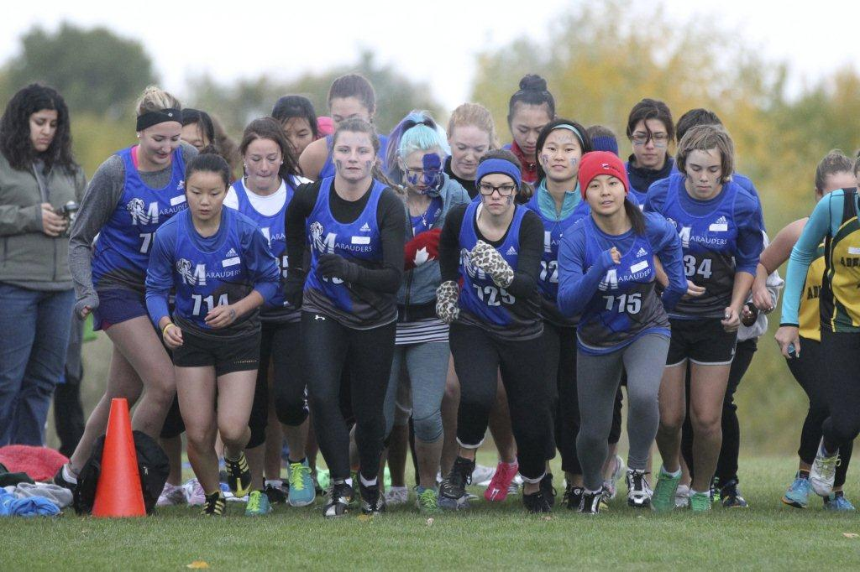
High Schools offer:
A variety of classes
New friends
Responsibility and independence
Extracurricular activities
Notes:
High school is different from elementary school. As you go through grades 9 – 12 you have more and more choice in the classes you can take. Most likely you will have many different teachers in each term. There will be an opportunity to meet many new friends from all over the city. The expectation will be that you take more responsibility and show increasing independence as both a learner and community member. There will also be opportunities to get involved in athletics, clubs, arts events, and other extra-curricular offerings outside of the school day – this certainly helps reduce stress!

Slide 8
How do you choose the right school for you?
Programming options
Proximity and transportation
Electives
Size of School
VIEW ALL the OPEN HOUSES!
Notes:
Students should consider many things when selecting a high school – not just where their elementary friends are going! Different collegiates have different programming – It is important to consider what type of courses or programs you are interested in or would like to try. Some of our collegiates are larger than others - the size of the school may be a factor in your decision. Generally, the bigger collegiates have more class options for students to choose from, however, some of the smaller collegiates have courses that are unique to them. Some people may select their closest collegiate because they want the ability to walk or bike to school. Others may be willing to take the bus or travel further distances to attend the school of their choice. Currently a high school student can obtain a monthly bus pass for $59.00.

Slide 9
VIRTUAL Collegiate Open Houses
Collegiates are welcoming students and families with virtual open houses. Check out Saskatoon Public Schools on YouTube beginning Feb. 7.
Notes:
Open Houses will be virtual this year – you can access them on the collegiate or division’s YouTube pages.

Slide 10
Types of Collegiates
Comprehensive
Mount Royal
Walter Murray
Conventional
Aden Bowman
Bedford Road
Centennial
City Park School
Evan Hardy
Marion Graham
Nutana
Tommy Douglas
Online Learning Secondary
Associate School
Saskatoon Misbah School (Grade 9)
Notes:
The two types of collegiates in Saskatoon Public Schools offer all the necessary programming for students to meet the ministry of education graduation requirements. Comprehensive collegiates have enhanced facilities that enable them to offer many additional practical and applied arts courses not found at conventional collegiates. Examples are welding, electronics, graphic arts, commercial cooking, automotive, cosmetology and esthetics.

Slide 11
Collegiate Programming
French Immersion Centennial, Marion M. Graham, Online Learning Secondary, Tommy Douglas, Walter Murray
SAGE Academically Gifted Education Bedford Road, Walter Murray
Advanced Placement *Additional Fees May Apply Centennial, Evan Hardy, Marion M. Graham, Tommy Douglas
International Baccalaureate Program (Grades 11-12) Aden Bowman, Bedford Road *Additional Fees May Apply
Alternate Education Work Study
Functional Living Skills
Notes:
French Immersion programming continues into high school as does SAGE. Advanced Placement classes are offered for students primarily in grades 11 and 12. Students write a board exam that could result in earning university credit. Course offerings vary by collegiate. International Baccalaureate Program begins officially in grades 11 and 12, however, there are some prep courses you can take in grades 9 and 10. The Alternate Education Work Study is for students who will work towards alternative credits. Your elementary team would have spoken with you if the and the Functional Living Skills program are a good fit for you.

Slide 12
Grade 9 Program
Compulsory Subjects
English 9A
English 9B
Math 9
Social Studies 9
Science 9
Health 9
Career Education 9
Physical Education 9
Arts Education 9
Practical & Applied Arts 9
Schools will adapt instruction to meet individual students’ academic needs.
Notes:
These are the courses required by the ministry for a grade 9 students. Each collegiate may offer them in a slightly different way. In addition, schools will adapt instruction to meet the academic needs of individual students.

Slide 13
Grade 9 Program
In addition to the compulsory subjects, students are able to choose at least one elective (varies depending on high school)
Electives
Some examples are:
Band 9
Choral 9
Cree 9
French 9
Variety of Practical and Applied Arts Classes
Examples are:
Technologies 9
Computer and Commerce Applications 9
Home Economics 9
Support Classes
English as an Additional Language Support
Resource Support
Notes:
In addition to the compulsory subjects, students in grade 9 can choose at least one elective. Not all high schools offer the same electives. This slide shows some example. Consult the Collegiate Handbook to see elective choices and PAA rotation options for each school.

Slide 14
Unique Programs
Our collegiates are home to a number
of unique programs for students.
Challenging students to think in multiple ways
Hands-on learning
Apprenticeship opportunities
Immersion in the environment
Education for sustainable development
Notes:
Do you recall unique opportunities in your elementary schooling such as I-Gen, Let’s Lead, Ecoquest, Creative Action? Students can continue to take advantage of unique opportunities as they enter high school also. All the opportunities are highlighted in our unique program’s handbook.

Slide 15
Grade 9 Unique Programs
Collective Voice Aden Bowman Collegiate
Integrated half-day, full-year Grade 9 program
Combining Social Studies, English Language Arts, and Arts Education
The focus of the program is learning in community, investigating the roots of inequality and injustice, and empowering students to find their voice and share it
Off the Grid Tommy Douglas Collegiate
Integrated half-day, full-year Grade 9 program
Combining Social Studies 9, Science 9, English Language Arts 9A, and Arts Education
The program is intended for students who are interested in such topics as climate change, sustainable living, social justice and the growing need for innovation in these areas
Notes:
Grade 9 students can take advantage a variety of system unique program.
Collective Voice – Aden Bowman Collegiate - Full year, half day program with emphasis on learning through collaboration, group work, and community building. The focus is on connections between land, culture, history, environment, literature, and social justice. Courses covered are ELA9A, ELA9B, Social Studies and Arts Education.
Off the Grid – Tommy Douglas Collegiate
Full year, half day program with emphasis on learning through an interdisciplinary adventure. Focus on climate change, sustainable living, social justice, and the growing need for innovation in these areas. Courses covered are Social Studies, Science, ELA9A, and Arts Education.

Slide 16
Grade 9 Unique Programs
Land-Based Education Bedford Road Collegiate
Integrated, year-long Grade 9 program
Available classes are Physical Education, Social Studies, English, Health and Career Education.
The program takes an environmental approach to learning that recognizes the deep connection and relationship of students to their place in the world and to the land.
Softball Academy Tommy Douglas Collegiate
Semester-long program for Grade 9-12 students
Students enrolled in Softball Academy have the opportunity to hone their softball skills as part of the program.
Available classes for Grade 9 students are Physical Education 9 and Career/Work Education 9.
Notes:
The Land-Based education program at Bedford Road is an integrated, year-long program. The classes included are PE9, SS9, English, Health and Career Ed. The program takes an environmental approach to learning that recognizes the deep connection and relationship of students to their place in the world and to the land.
The Softball Academy at Tommy Douglas Collegiate is a semester-long program for Grade 9-12 students. Students enrolled in the Academy have the opportunity to hone their softball skills. Available classes for Grade 9 students are Physical Education 9 and Career/Work Education 9.

Slide 17
Grade 9 Flexible Programming
FLEX Program City Park School
Allows students to balance their education with high-level involvement in athletics or the arts.
Open to students in Grades 6-12
Flexible school-day schedule to meet individual needs
Face-to-face and online learning opportunities
Program fosters independence and responsibility
Online Learning Secondary Marion Graham Collegiate
Full or part time Grades 9-12 learning opportunities for high school students
Live teaching sessions compliment the independent course work
Students benefit from flexibility in their day, unique online instruction, and class offerings that are not always available at their home collegiate
Notes:
Flex Program – City Park Collegiate - Blended Learning Program that allows students in Grades 6-12 a flexible schedule so they can participate in skill development within athletics, or the arts outside of traditional school offerings.
Online Learning Secondary – Students can take full or part time courses through their high school experience. Students have opportunities to connect with classmates and teachers through live sessions in conjunction with the independent work in the virtual learning management system.

Slide 18
Counselling Services
Educational Planning
Course Selection
Personal Counselling
Career / Vocational Counselling
Notes:
Every Saskatoon Public Schools' collegiate offers a variety of services to assist students with high school and post-secondary education plans and career planning. Collegiate counsellors also provide information and resources about healthy relationships and lifestyles, family and personal issues and overall student wellness. Examples of the many services oﬀered by Student Services staff in each of our collegiates include assistance with course planning and graduation requirements, planning for post-secondary education, information and assistance with scholarship applications and other education funding opportunities.

Slide 19
Notes:
This Graduation Plan prepared by Saskatoon Public Schools breaks down how students are supported in each grade throughout their high school career. This document is used by school counsellors, career facilitators, some subject teachers and students as a guide for course selection to ensure students meet graduation prerequisites.

Slide 20
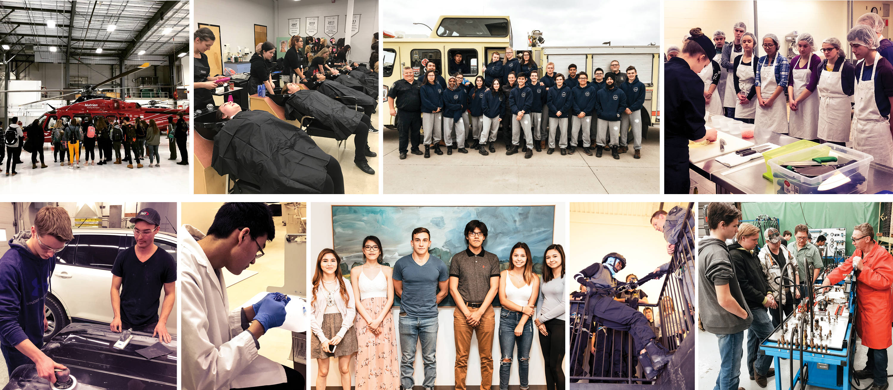
Partnerships to Enhance Learning
Notes:
Saskatoon Public Schools has numerous partnerships to support students in a variety of ways. Many Saskatoon businesses support student out of school experiences, which promote learning in courses such as Entrepreneurship, Food Studies, and Law. Others support in schools, as guest speakers providing information on a variety of topics. Some professionals in the community mentor students, such as Myers Norris Penny employees. Arts opportunities exist through the Remai Art Gallery, Persephone theatre, the Saskatoon Symphony to name a few.
Established in 2003, the Okicīyapi (O-kitch-ee-yapi) Educational Partnership promotes First Nations, Inuit and Métis education by developing and implementing services, programs and curricula at Saskatoon Public Schools and in Saskatoon Tribal Council schools. When translated, Okicīyapi Partnership means working together for the better good. Members of the Okicīyapi Partnership include: Saskatoon Public Schools, Saskatoon Tribal Council First Nations, and Central Urban Métis Federation Incorporated.
The Saskatoon Health Region works in support of students and teachers. Health nurses support teaching and working with students, access supports for students with diverse needs, and help students explore a variety of health-related careers.
We also partner with post-secondary institutions and the Saskatoon Industry Education Council to support students with orientation, spend-a-day and out-of-school learning activities.

Slide 21
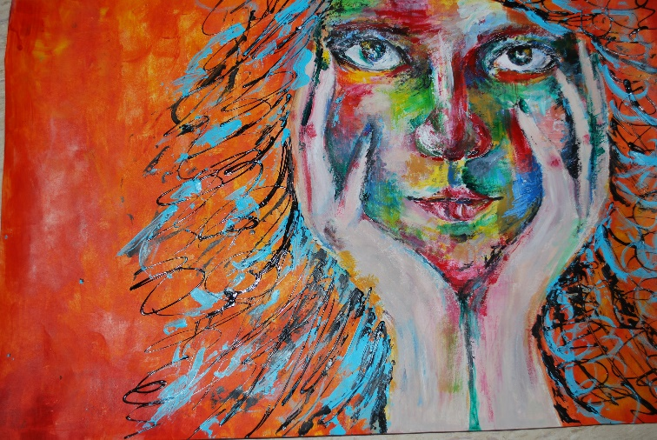
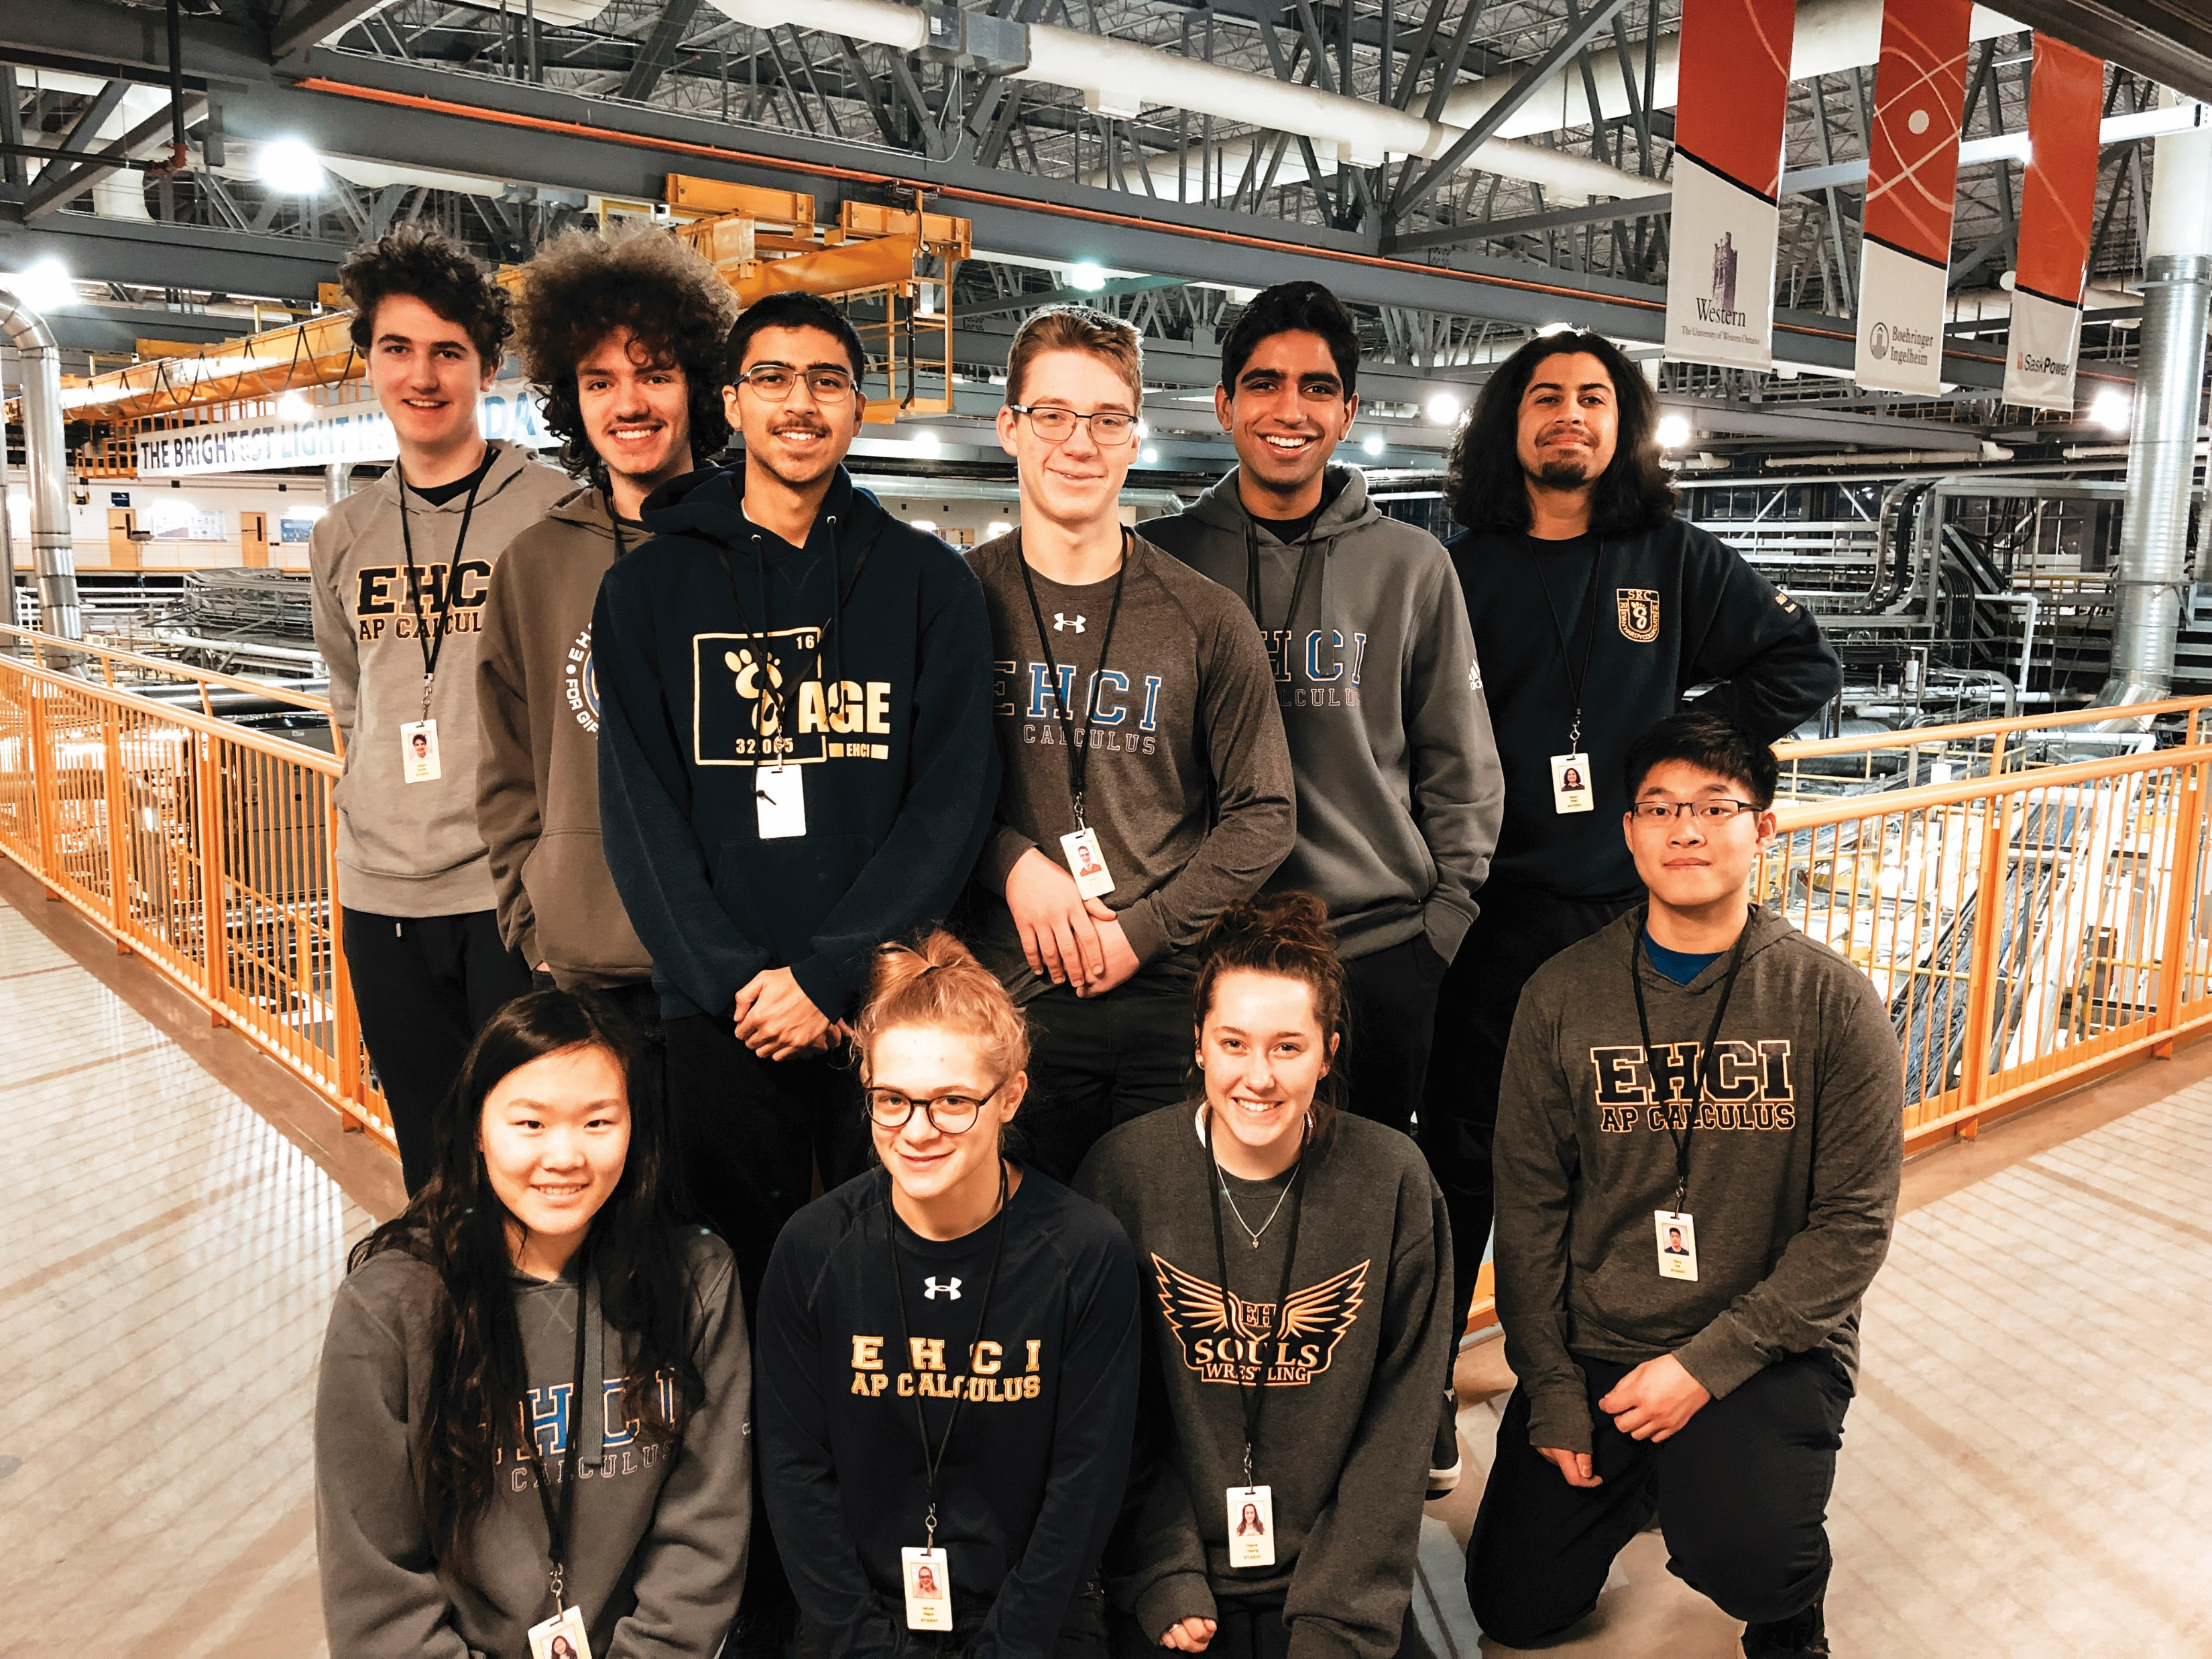
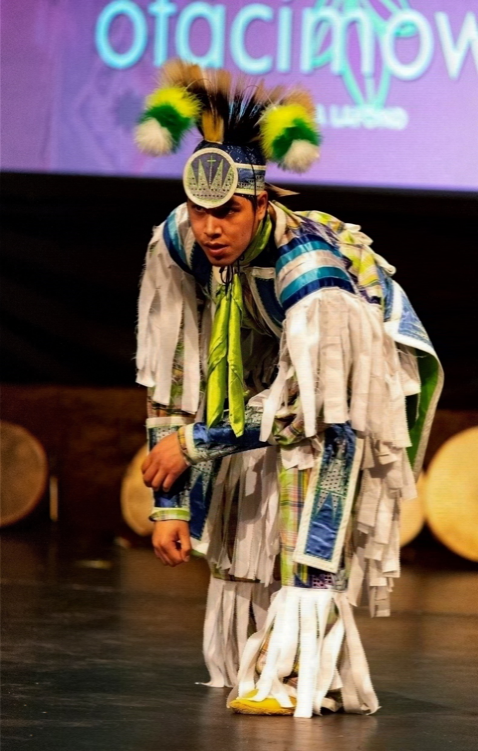
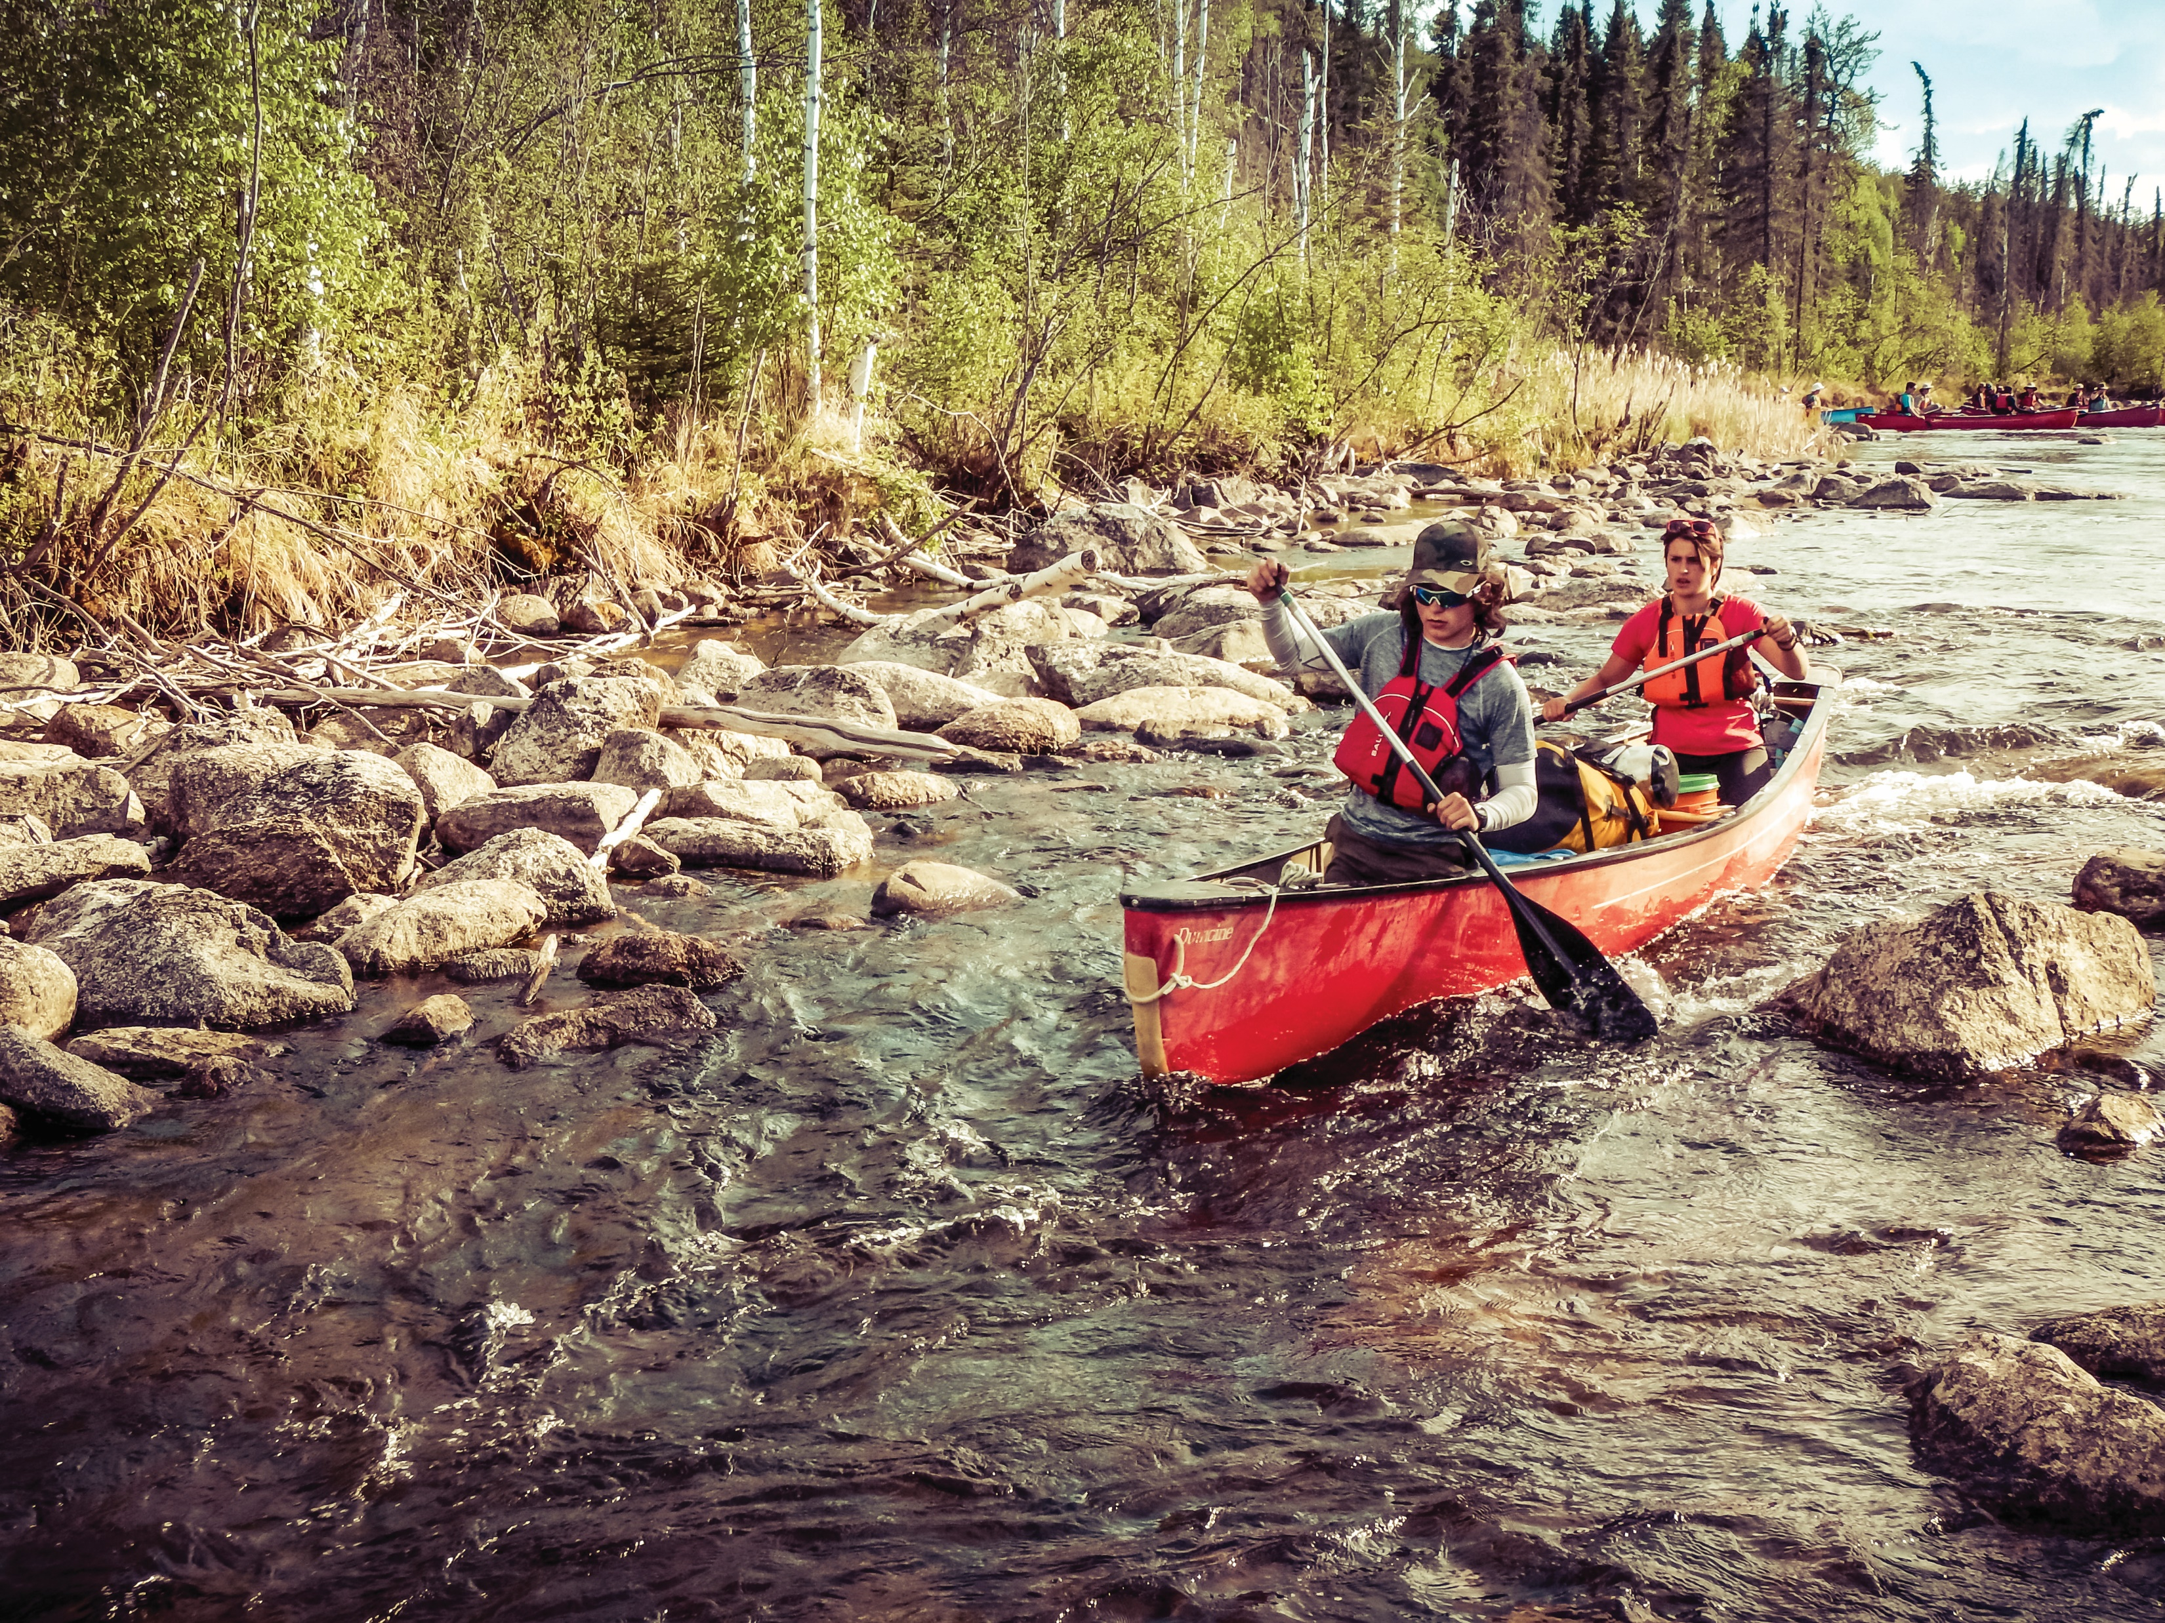
Extracurricular & Clubs
Students – get involved to make new friends and become part of your new school.
Notes:
One of the best parts of high school is the additional opportunities students have to become involved in the school community beyond the classroom walls. Extra Curricular and clubs provide an opportunity to meet new people, pursue a passion, try something new, or just take a break from the rigor of your class load.

Slide 22
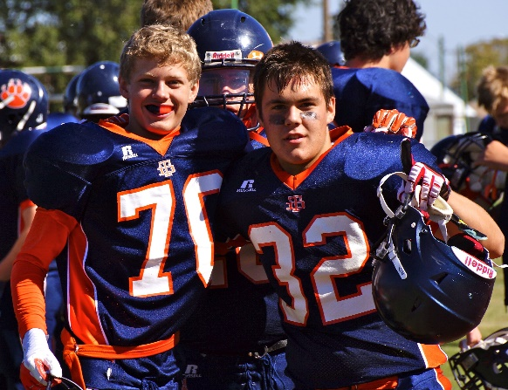
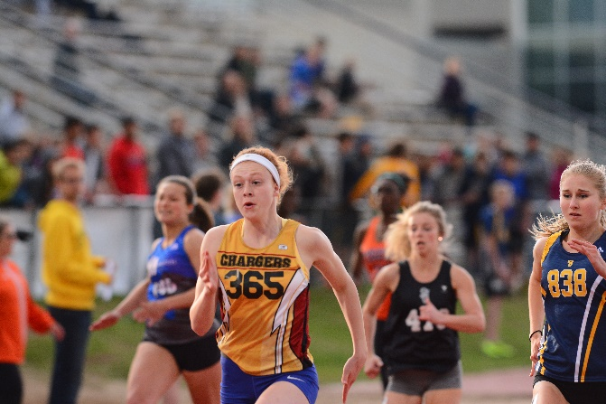
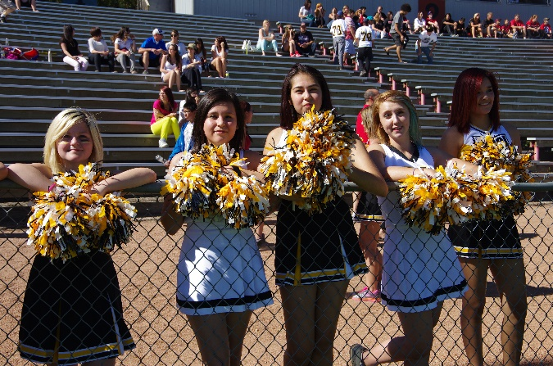
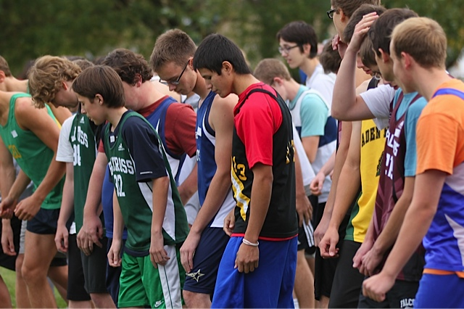
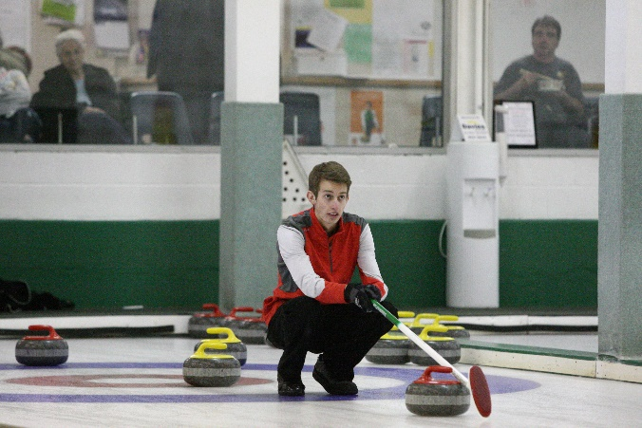
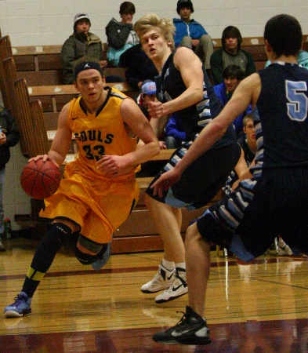
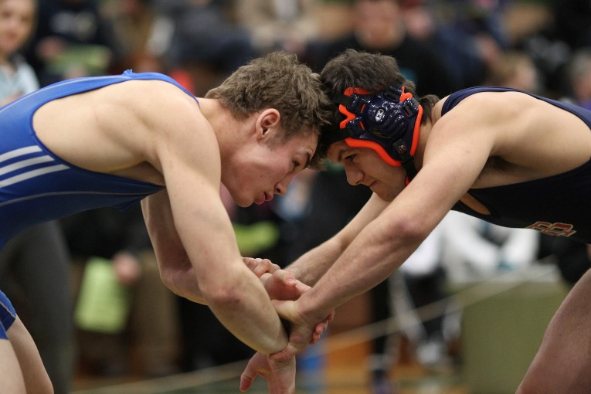
Athletics
Volleyball
Curling
Cheerleading
Soccer
Wrestling
Golf
Pom Squad
Football
Badminton
Basketball
Cross-Country Running
Track & Field
Weight Training
Notes:
Almost every high school has team and individual sports in addition to clubs and other extra curricular opportunity. Check out the fitness centres and noon hour gym events as well as the teams.

Slide 23
CAREGIVERS
Continue to stay involved!
School community council
Attend games / performances
Work with teachers to support learning
Please contact your elementary or high school with any questions about the transition process.
Notes:
Just because your student is moving into high school doesn’t mean parents shouldn’t stay involved. In fact, the partnership becomes even more important.

Slide 24
Grade 8 to 9 Registration Process
January Pre-Collegiate Night – THANK YOU FOR ATTENDING
Check in from collegiate counsellor with Grade 8 classroom following the Pre-Collegiate Night – ask any questions you may still have!
View collegiate virtual Open Houses beginning February 7, 2022
A one page PDF will be provided with links for all open houses
Apply for any Unique Programs directly with collegiates
A one page PDF will be provided with descriptions and links for all unique programs
Notes:
Here is a timeline of the registration events. Both the elementary school and high schools will work hard to assist each of you with this transition.

Slide 25
Grade 8 to 9 Registration Process
Link to a virtual registration form will be provided by the elementary school on February 17, 2022 – if you are unable to access the virtual form and require a paper copy, please speak to the grade 8 teacher
Virtual registration forms should be completed by Friday, March 4, 2022
March 7-11, 2022 Individual interviews with high school counsellor to confirm registration, course selection, and answer any questions about Grade 9
Spring 2022 Welcome letter and more specifics about courses sent to grade 8 students – Thursday, June 30, 2022 potential Collegiate Orientation in the morning
Notes:
Here is a timeline of the registration events. Both the elementary school and high schools will work hard to assist each of you with this transition.

Slide 26
Contact Information
Saskatoon Public Schools
310 - 21st Street East
Saskatoon, Saskatchewan Canada S7K 1M7
Telephone 306.683.8200
Email spsdinfo@spsd.sk.ca
Twitter @StoonPubSchools
Facebook facebook.com/SaskatoonPublicSchools
Instagram instagram.com/SaskatoonPublicSchools
Youtube youtube.com/SaskatoonPublicSchools13
Linkedin linkedin.com/company/saskatoonpublicschools
Web saskatoonpublicschools.ca
Notes:
Thank you again for coming this evening. Questions?

